Slide 1
GARWARE-WALL ROPES LTD.
COATED FABRIC
All that you want us to be, and then a bit more

Slide 2
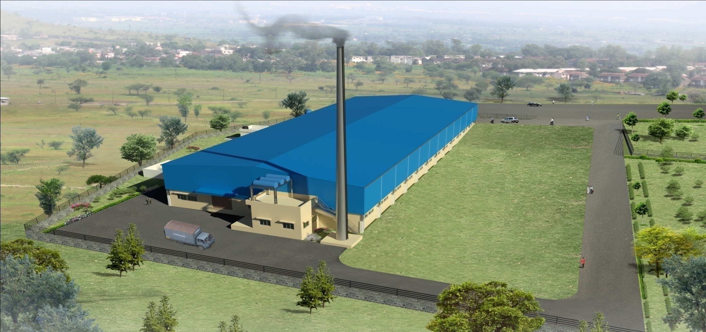
B
GWRL Infrastructure
Coated Fabric Plant is located in Wai in an Area of 3300 sq meters

Slide 3
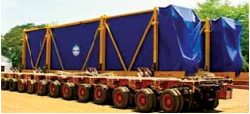
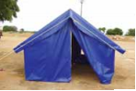
B
GWRL Infrastructure
Coated Fabric Solutions Portfolio…
DOUBLE SIDE COATED
SINGLE SIDE COATED
Tarpaulin
Hanger Cover
Awnings
Pandals
Tents
Inflatables
Biogas Covers
Pitch Cover/Ground Covers
Awnings
Inflatables
Auto Hood Covers
Tractor Covers

Slide 4
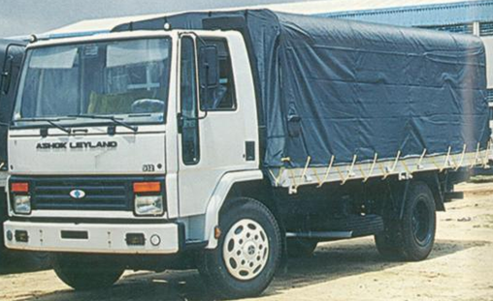
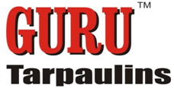
B
GWRL Infrastructure
Tarpaulin: Truck Tarpaulins & Container Covers
Advantages of GURU PVC Tarpaulin over ordinary Cotton & Plastic products:
100% Waterproof
UV Resistant material
Uniform Thickness
Strong heat sealed Joints
No Shrinkage like Cotton
Tarpaulins
Extremely Strong
Light Weight
Longer Shelf Life
Repairable

Slide 5
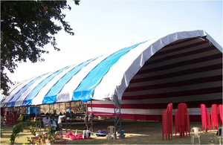
B
GWRL Infrastructure
Hanger Cover: Aircraft Hangers, Temporary Exhibition Halls & Warehouses
Features /Benefits:
100% Waterproof
Longevity & Sustainability
UV Resistant
Heat Retardant*
Extremely Strong
Light Weight
Repairable
High Quality Accessories:
UV Resistant Ropes
designed to sustain 4 ton
ropes
*Optional but Recommended

Slide 6
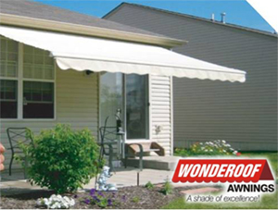
B
GWRL Infrastructure
Awnings: Retractable/Stationary Awnings, Balconies Awnings & Restaurant Umbrellas
Features /Benefits:
100% Waterproof
Longevity & Sustainability
UV Resistant
Good Coating Adhesion
Lacquered /Non Lacquered
as per demand
Heat Sealable
Repairable
Different colors with high
color fastness (Grade 7)

Slide 7
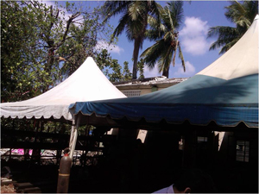
B
GWRL Infrastructure
Pandals: Pandals for Marriages/Religious Ceremonies
Features /Benefits:
Designed for Robust Use
Fire Resistant*
100% Waterproof
Longevity & Sustainability
UV Resistant
Customized: Ready to Install
Available in Different
Colors
*Optional but Recommended

Slide 8
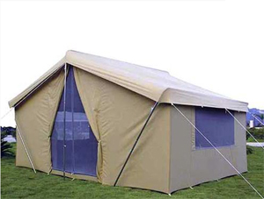
B
GWRL Infrastructure
Tents:Tents for Resorts, Tents for NGO, Tents for Trekking & Promotional canopies
Features /Benefits:
100 % Waterproof
Longevity and Sustainability
UV resistant material
Fire resistant*
Antifungal can be supplied
on demand
Lacquered/Non Lacquered
as per requirement
Available in different colors
*Optional but Recommended

Slide 9
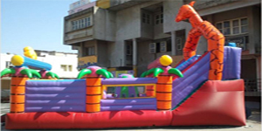
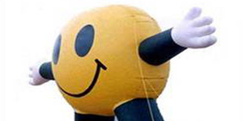
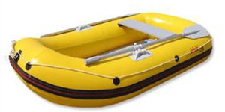
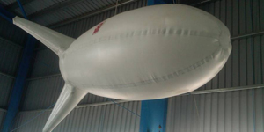
B
GWRL Infrastructure
Inflatables: Bouncies, Promotional & Aerostat Balloons, Inflatable Boats & Water storage tanks

Slide 10
B
GWRL Infrastructure
Inflatables: Bouncies, Promotional & Aerostat Balloons, Inflatable Boats & Water storage tanks
Features /Benefits:
High breaking Strength
Puncture resistant for robust
use
Longevity and Sustainability
Low air permeability
UV resistant
Different colors
Lacquered/Non lacquered

Slide 11
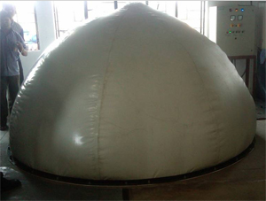
B
GWRL Infrastructure
Biogas Covers
Features /Benefits:
Sealing joint as strong as
fabric
(High frequency sealing)
Longevity & Sustainability
Fire resistant
High Bursting Strength
Very low air permeability

Slide 12
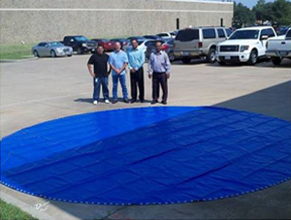
B
GWRL Infrastructure
Inflatables: Bouncies, Promotional & Aerostat Balloons, Inflatable Boats & Water storage tanks
Features /Benefits:
100% Water resistance
Longevity & Sustainability
Durable with high Abrasion
resistance and UV stability
Tailor made
Easy to repair

Slide 13
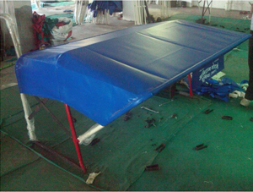
B
GWRL Infrastructure
Inflatables: Bouncies, Promotional & Aerostat Balloons, Inflatable Boats & Water storage tanks
Features /Benefits:
100 % waterproof
Longevity and Sustainability
UV resistant
Good coating adhesion
Lacquered/ Non Lacquered
as per demand (Dust proof
Lacquered material)
Different colors with high
color fastness (Grade 7)

Slide 14
D
Solutions Offered
‘Garware-Wall Ropes’ a name that stands for Trust, Innovation & Quality…
Impeccable Quality
Trust
Innovation
Customer Service

Slide 15
Thank you
We look forward to hearing from you…
GARWARE-WALL ROPES LTD
Plot No 11,
Block D1, Pimpri Chinchwad
Pune, Maharashtra-411019
www.garwareropes.com

